Slide 1

Integration testing
Apache Kafka
August - 2021

Slide 2
Summary
Overview
Dependencies and config
Integration testing for a Consumer
Integration testing for a Producer

Slide 3
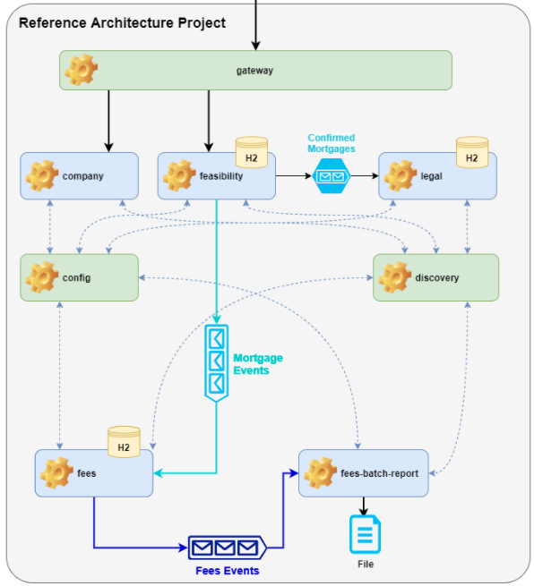
1. Overview
Microservice to test: Fees-module

Slide 4
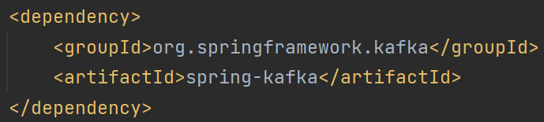
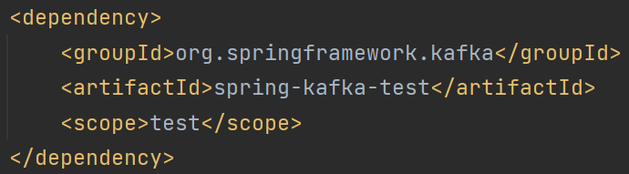
2. Dependencies and configuration
(pom.xml)

Slide 5
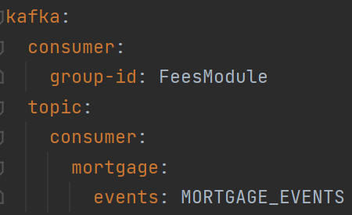
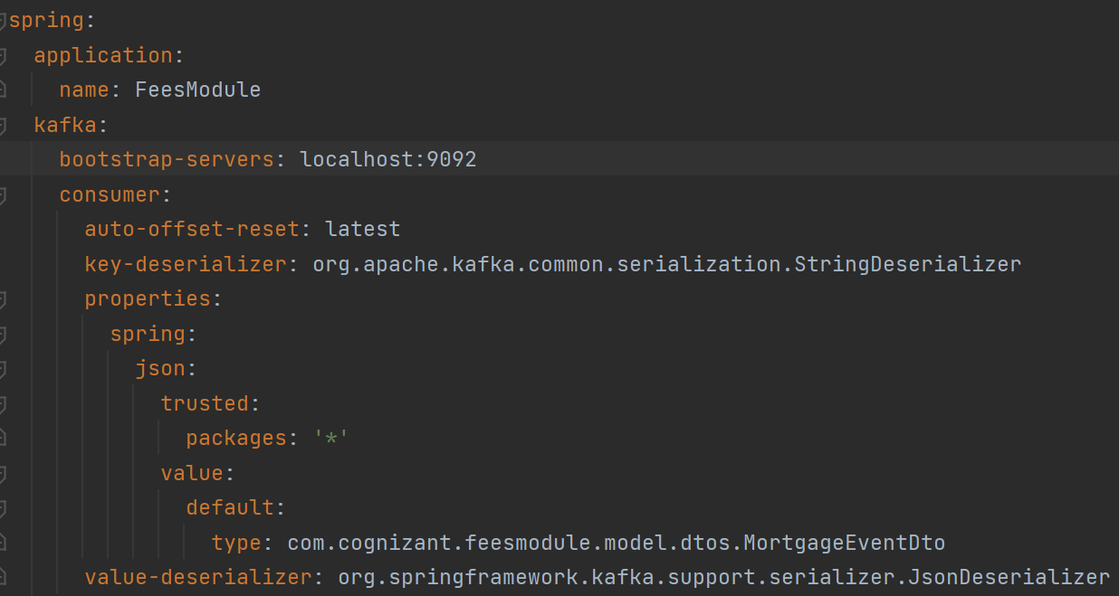
(application-integration.yml) Kafka configuration

Slide 6
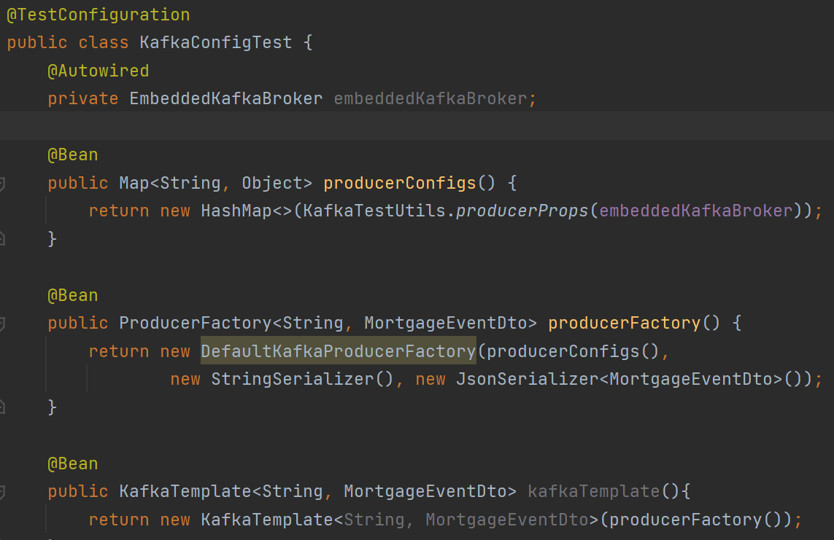
3. Integration-testing for the Consumer
We create a fake Producer (kafkaTemplate)

Slide 7
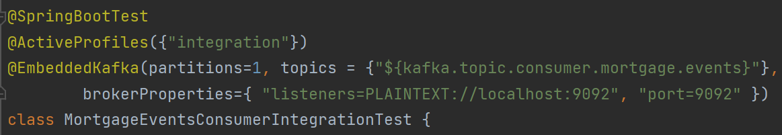
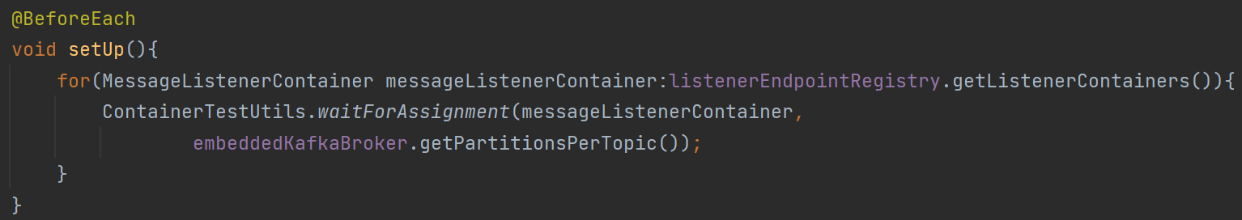
(test) We use an embedded-kafka as the broker, and wait for the broker-partitions to be created.

Slide 8
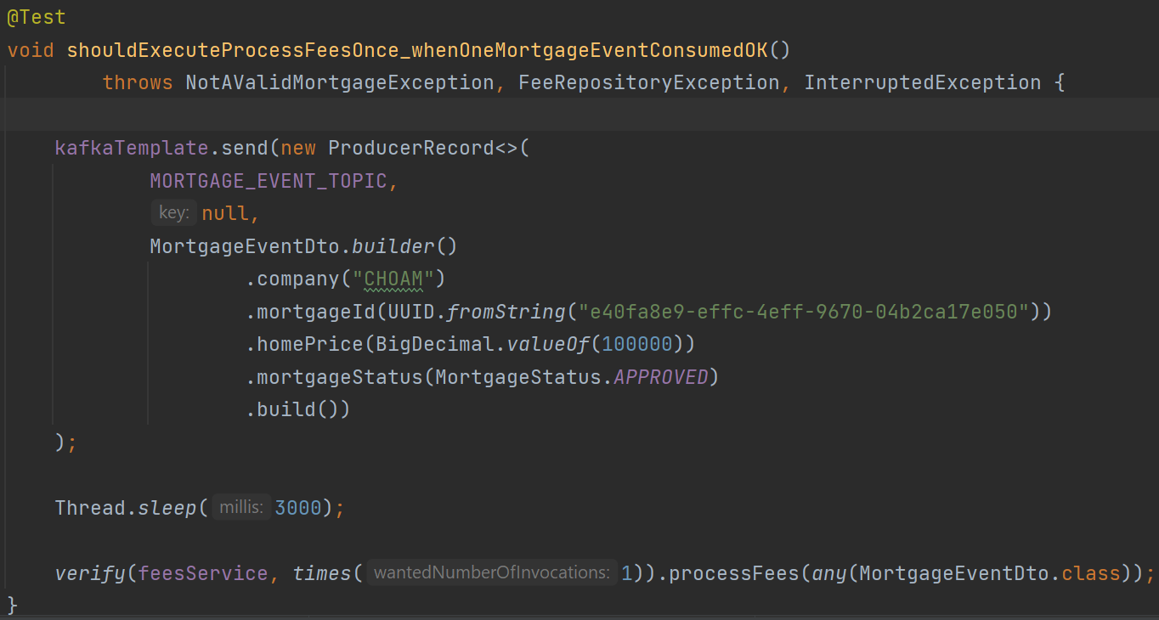
(test) The fake-Producer publishes an event into the topic, and we verify that the real Consumer gets it.

Slide 9
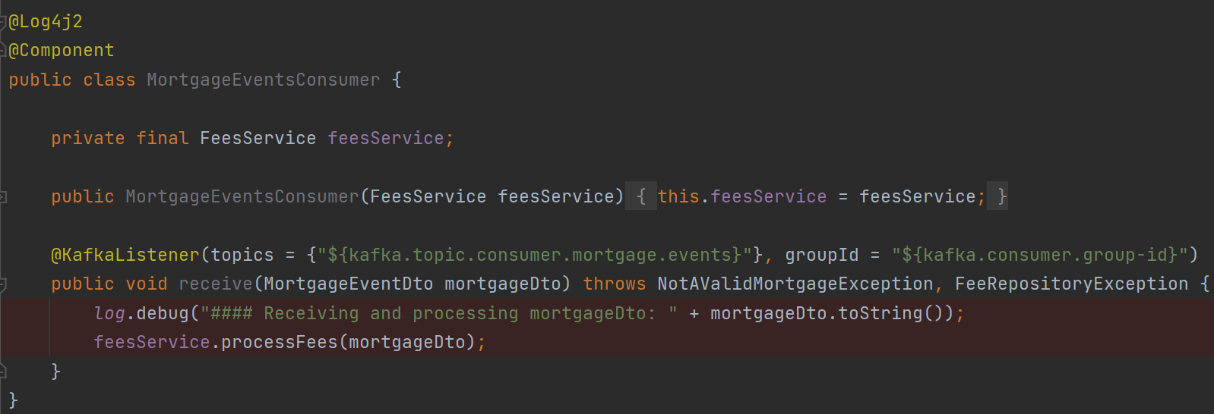
(Consumer)

Slide 10
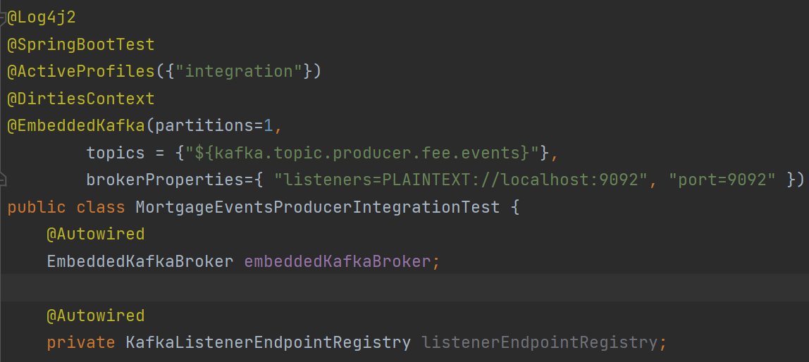
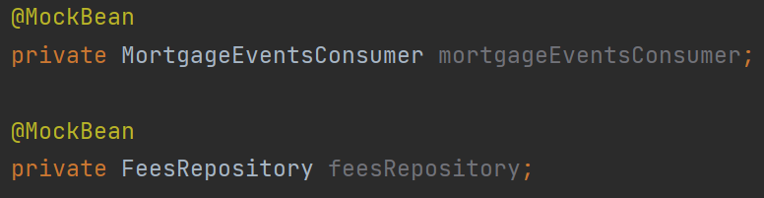
4. Integration-testing for the Producer
- [test] We use an EmbeddedKafka and mock any other services not related to the Kafka publishing process

Slide 11
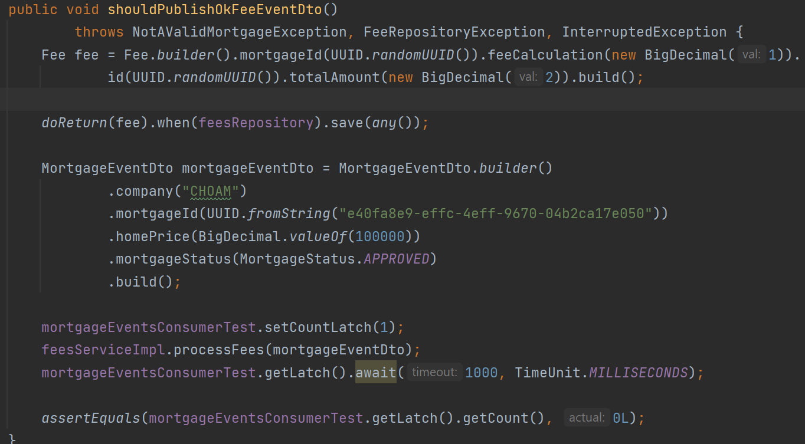
- [test] the Producer publishes the event, and we verify that the fake-Consumer gets it.

Slide 12
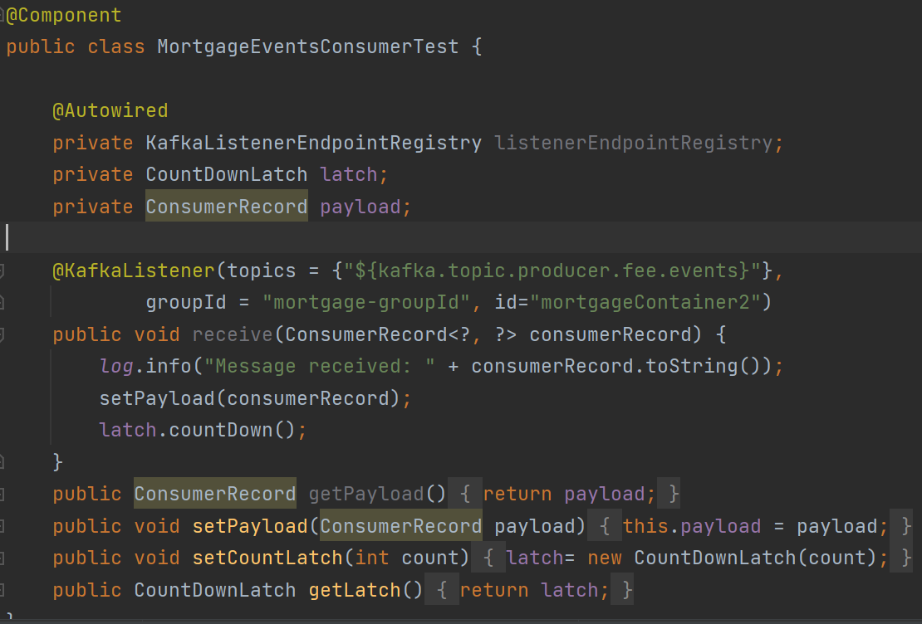
- [test] fake-Consumer

Slide 13
Thank you
Reference-Architecture project
By Hugo Mozo

Slide 14


